Slide 1
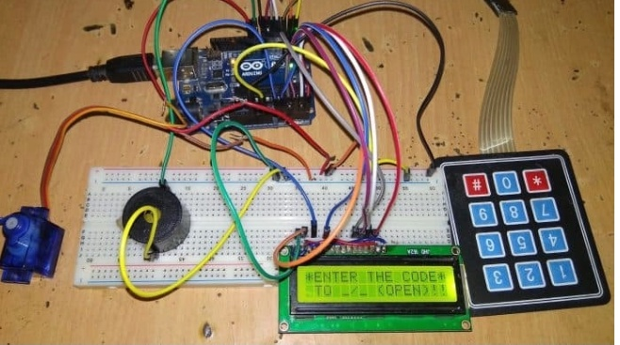
PASSWORD BASED DOOR LOCK SECURITY SYSTEM

Slide 2
ABSTRACT:
Security is a main concern in our everyday life. Each individual needs to feel secure. An access control for doors forms an essential part in our security pattern. Doors locked using conventional locks are not as safe as they used to be, anyone can break in by breaking these locks.
We must make a framework that will give 24/7 benefit password based door lock system allows only approved persons to access restricted areas. This system is fully controlled by Arduino. The password can be entered via a keypad. If the password is matched with the stored password in Arduino, the door gets open.
This programmed password based bolt framework will give client more secure and minimal effort method for locking opening framework. The security door lock automation system promises a bold step to the future where mechanical door locks will be substituted by electronic door locks.

Slide 3
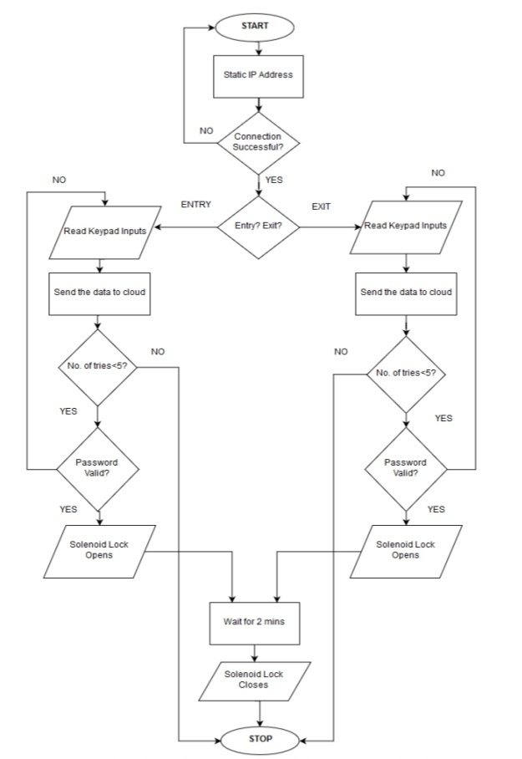
FLOW CHART:

Slide 4
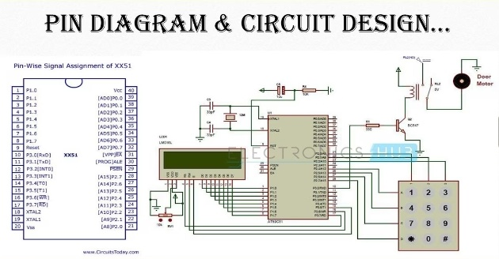

Slide 5
COMPONENTS USED:
Arduino UNO Board
4*3 Keypad
16*2 LCD Display
Potentiometer 10k
SG90 Servo Motor
Buzzer 5V
Connecting Wires

Slide 6
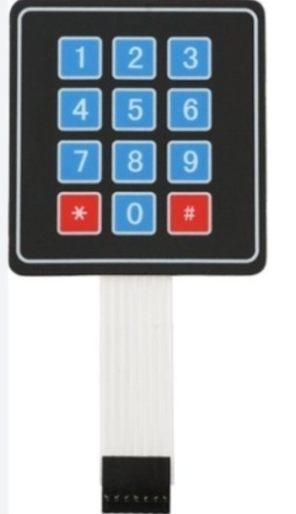
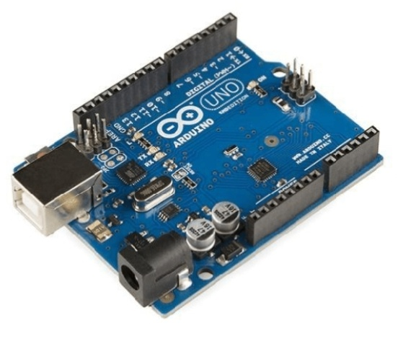
Arduino UNO Board 4*3 Keypad

Slide 7
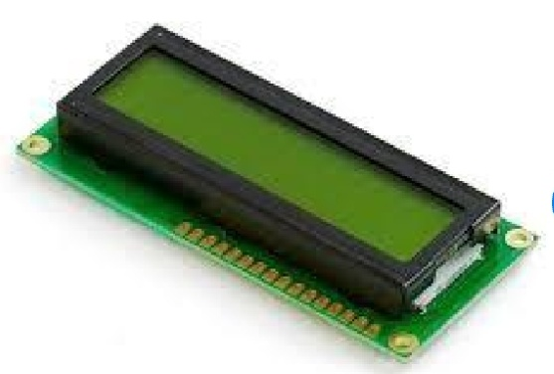
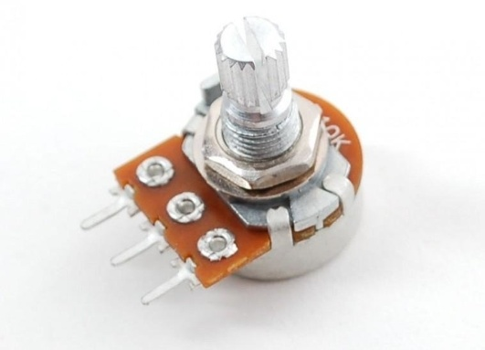
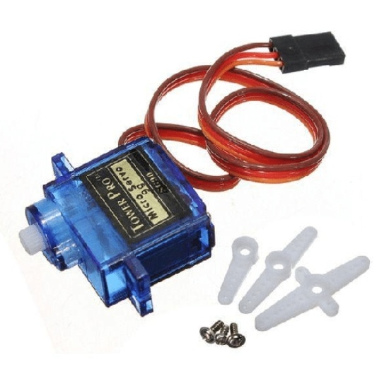
16*2 LCD Display POTENTIOMETER
SG90 servo Motor

Slide 8
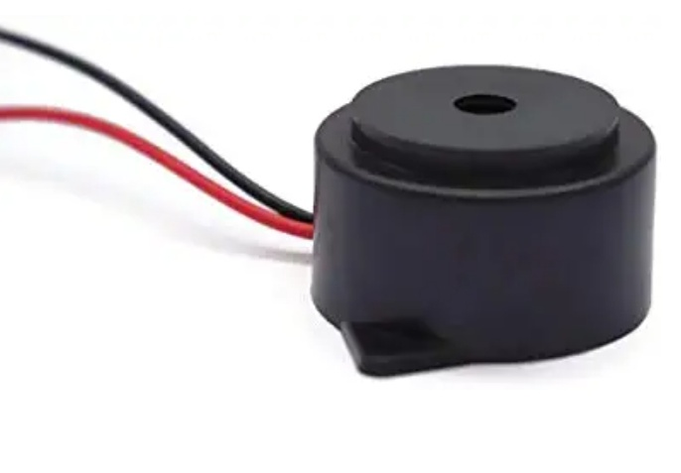

BUZZER 5V CONNECTING WIRES

Slide 9
THANK YOU

